Slide 1
Heading to the enterprise applications world
Your starting toolbox

Slide 2
Training Agenda
W1: Heading to the enterprise applications world. Your starting toolbox
W2: How Spring can improve your life as a programmer
W3: Dive into the Web
W4: Improve your application robustness with testing and API documentation
W5: What is Spring Boot and why is everyone using it

Slide 3
W1 Timeline
6th March, 14:30
Introduction, Java app and Maven
Let’s get to know each other
What is a Java application?
Build a Java app with Maven in IDE
6th March, 16:20
Lab exercises - part 1
Time to put in practice what you’ve just learned
6th March, 15:15
Break
Get up, grab a cup of coffee/tea and :)
6th March, 17:05
Break
Get up, grab a glass of water and :)
6th March, 15:25
Apache Tomcat + Git
What is Apache Tomcat?
What is Git?
6th March, 17:15
Lab exercises - part 2
Time to put in practice what you’ve just learned
6th March, 16:10
Break
Get up, grab a glass of water and :)

Slide 4

Let’s get to know each other
*Image from pexels.com, by Ivan Samkov

Slide 5
What is a java application?

Slide 6
Using IntelliJ Idea to create your first application

Slide 7
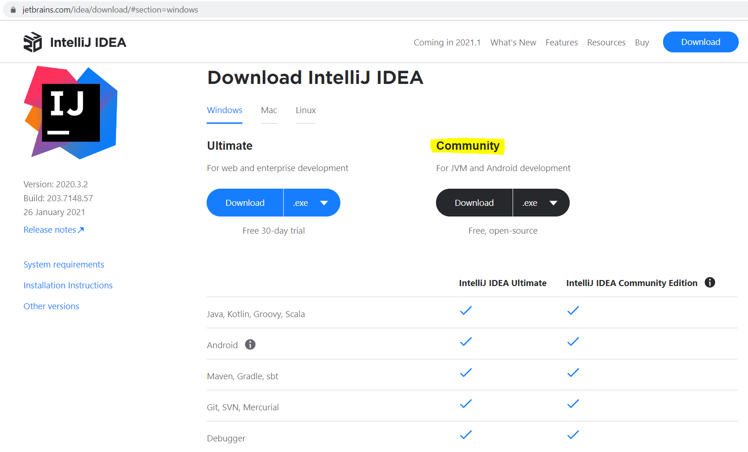
Using IntelliJ Idea to create your first application
IntelliJ IDEA Community edition jetbrains.com/idea/download

Slide 8
What is Maven?

Slide 9
What is Maven?
High level overview
Maven = Build tool
Maven = Project
management tool
Manages dependencies
Produces one artifact
Handles versioning/releases
Favours convention over configuration
Apache Software Foundation
Open Source

Slide 10
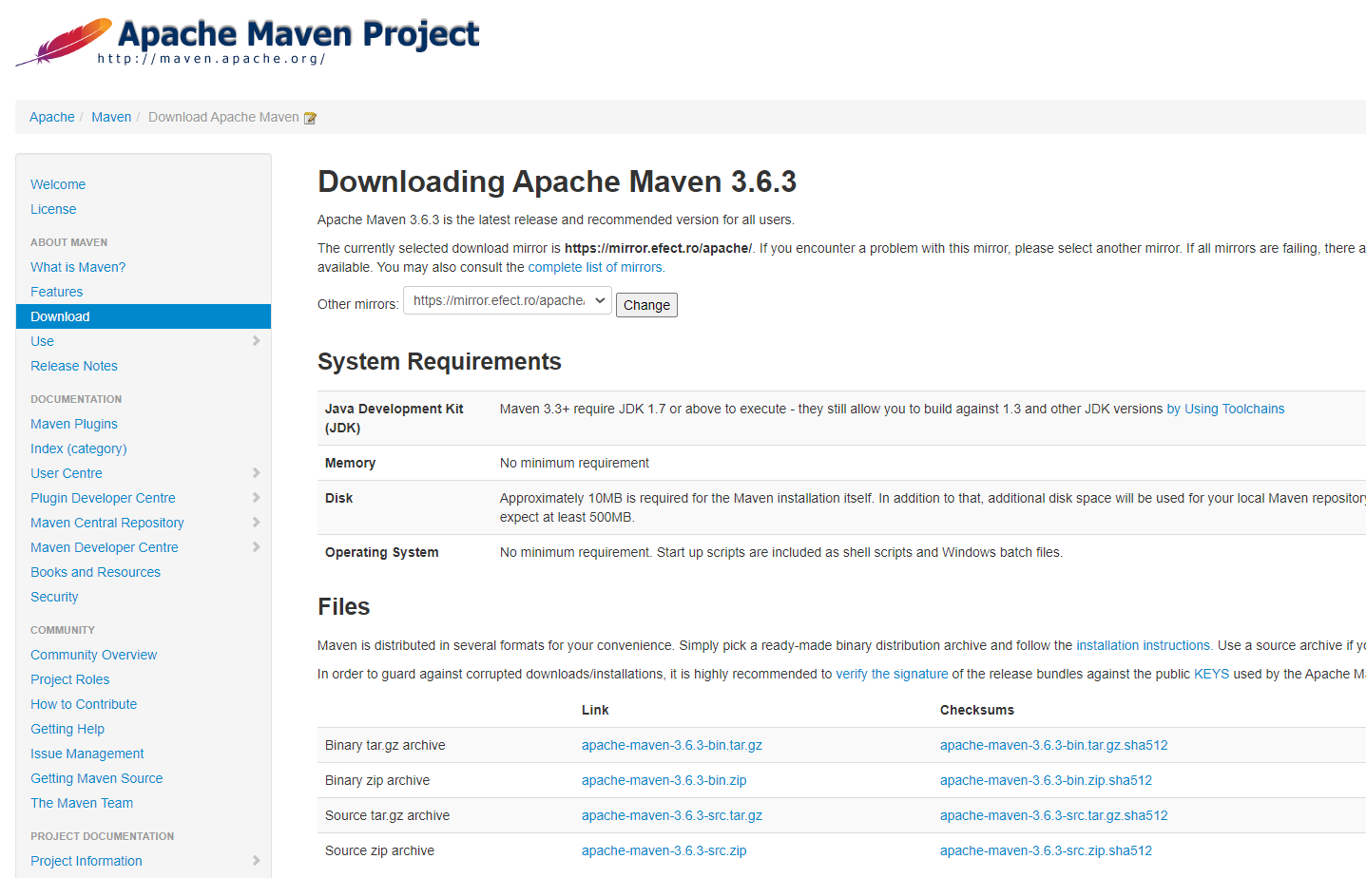
What is Maven?
Set up
Download 3.6.3 http://maven.apache.org/ Binary zip for Windows Binary tar for Unix

Slide 11
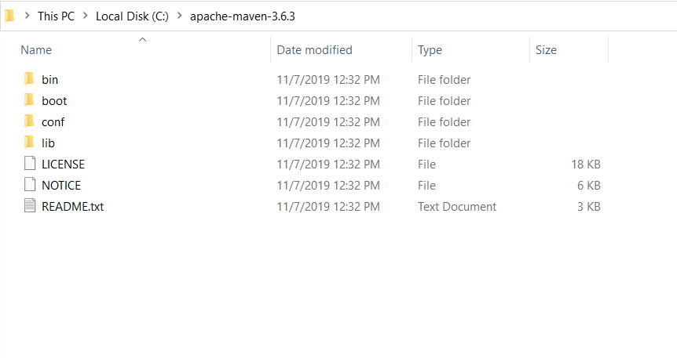
What is Maven?
Set up
Installation Unzip it and put it under the C drive

Slide 12
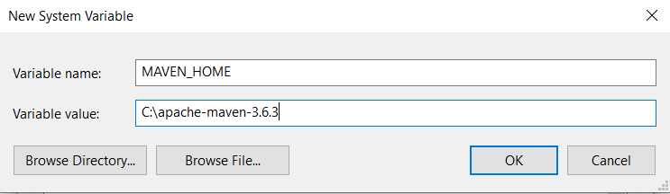
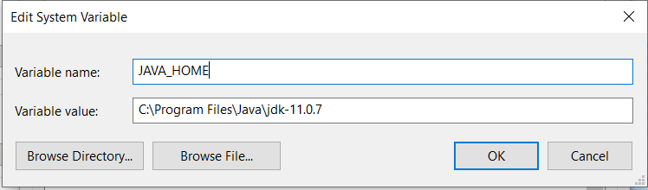
What is Maven?
Set up
Add environment variables JAVA_HOME MAVEN_HOME

Slide 13
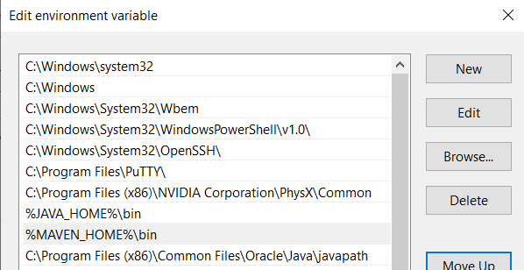
What is Maven?
Set up
Edit environment variable Path

Slide 14
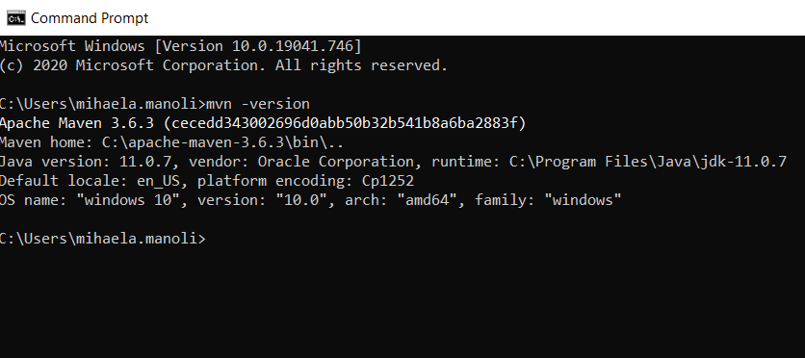
What is Maven?
Set up
Verify installation Open cmd Run mvn -version

Slide 15
What is Maven?
Folder structure
src
main
java
src/main/…
src
test
java
target directory
pom.xml
groupId
artifactId
version
packaging

Slide 16
What is Maven?
Goals
Goals
clean
compile
package
install
deploy

Slide 17
What is Maven?
Build section, defaults
Build section in pom file
<build> … </build>
Override defaults
E.g: <build>
<finalName> Payment</finalName>
</build>

Slide 18
What is Maven?
Demo
Create new simple Java project
Add pom.xml file
Add folder structure
Add HelloWorld.java
Run Maven goals from cmd:
mvn clean
mvn compile
mvn package
Chain goals
Notes:
<groupId>ro.fiipractic.training</groupId>
<artifactId>DemoMaven</artifactId>
<version>1.0-SNAPSHOT</version>
<modelVersion>4.0.0</modelVersion>
<packaging>jar</packaging>
<build>
<plugins>
<plugin>
<groupId>org.apache.maven.plugins</groupId>
<artifactId>maven-compiler-plugin</artifactId>
<version>3.8.0</version>
<configuration>
<release>11</release>
</configuration>
</plugin>
</plugins>
</build>

Slide 19
What is Maven?
Dependencies
GAV
groupId
artifactId
version
Versions
SNAPSHOT
Release

Slide 20
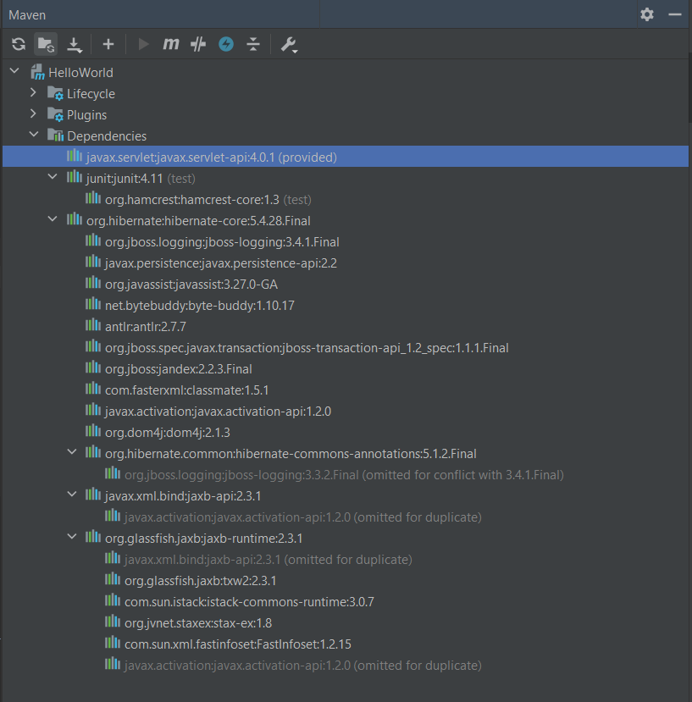
What is Maven?
Dependencies
Transitive dependencies

Slide 21
What is Maven?
Dependencies
Packaging Types
jar
war
ear

Slide 22
What is Maven?
Dependencies
Scopes
compile
provided
runtime
test

Slide 23
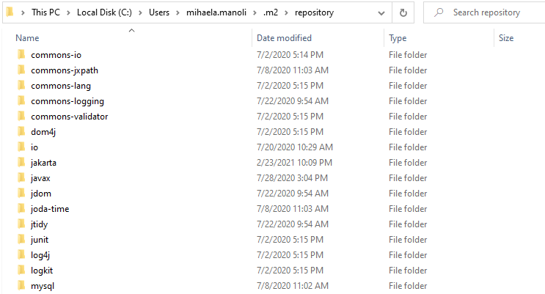
What is Maven?
Repositories
Local repository ~/.m2/repository/<groupId>/<artifactId>/<version>

Slide 24
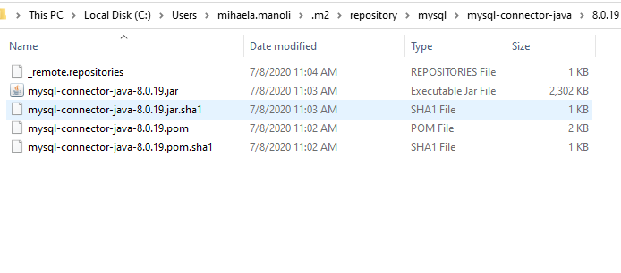
What is Maven?
Repositories
Local repository ~/.m2/repository/<groupId>/<artifactId>/<version>

Slide 25
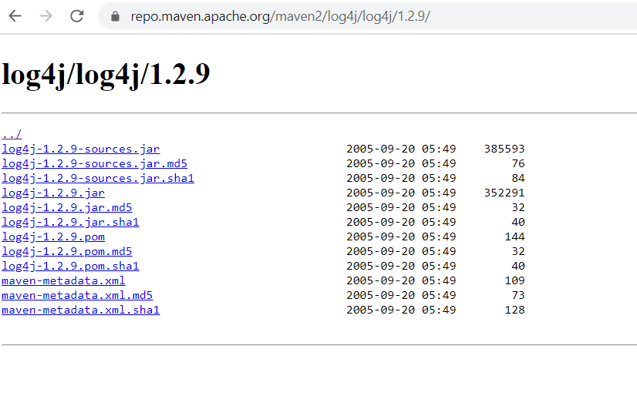
What is Maven?
Repositories
Remote repository repo.maven.apache.org/maven2 Multiple repos are allowed

Slide 26
What is Maven?
Repositories
Dependency repositories
Releases repositories
E.g:https://repo.spring.io/libs-release/
SNAPSHOTS repositories
E.g: https://repo.spring.io/libs-snapshot/
Plugin repositories

Slide 27
What is Maven?
Plugins
Goals
clean
compile
package
install
deploy
...

Slide 28
What is Maven?
Plugins
validate
compile
test
package
verify
install
deploy
Phases

Slide 29
What is Maven?
Plugins
Examples
Compiler plugin
Jar plugin
Javadoc plugin

Slide 30
What is Maven?
IDE integration
Import as Maven project
From existing sources
From VCS
Create as Maven project
Archetypes = projects templates
E.g. archetype: maven-archetype-webapp

Slide 31
What is Apache Tomcat?

Slide 32
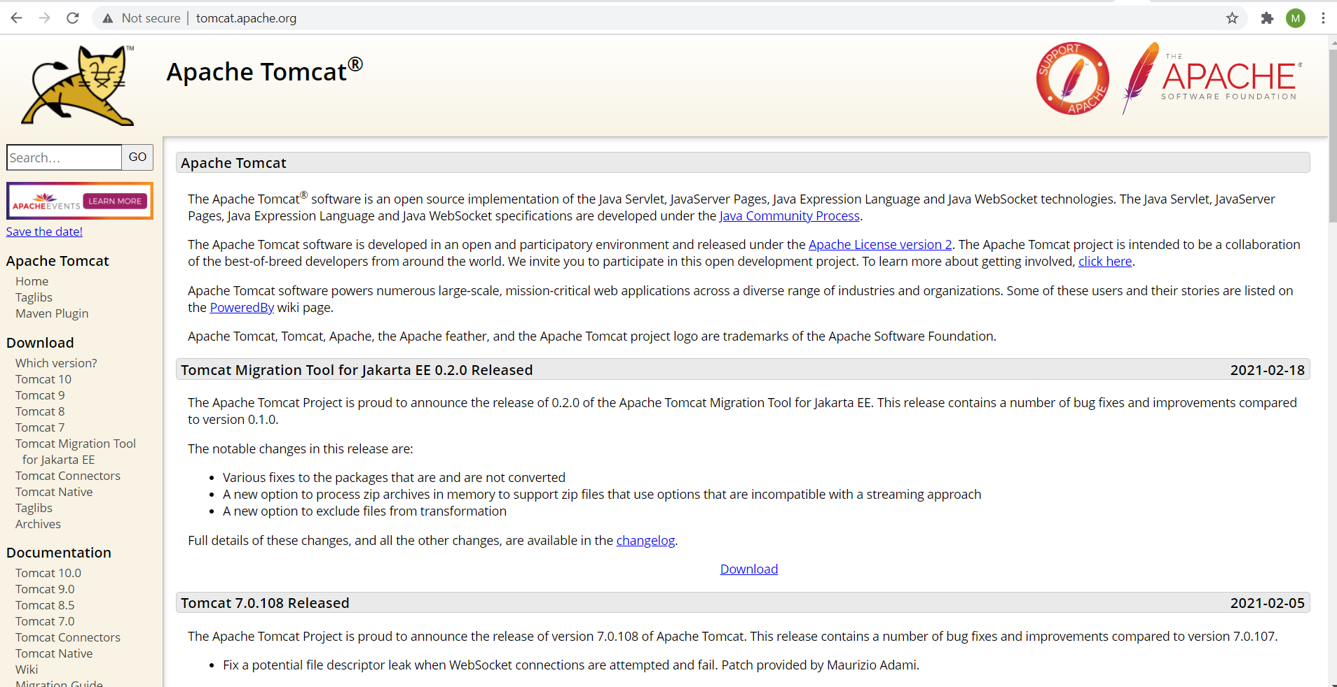
What is Apache Tomcat?
High level overview
Apache Tomcat Web server Maintained by Apache Open source Implements Servlet Specification

Slide 33
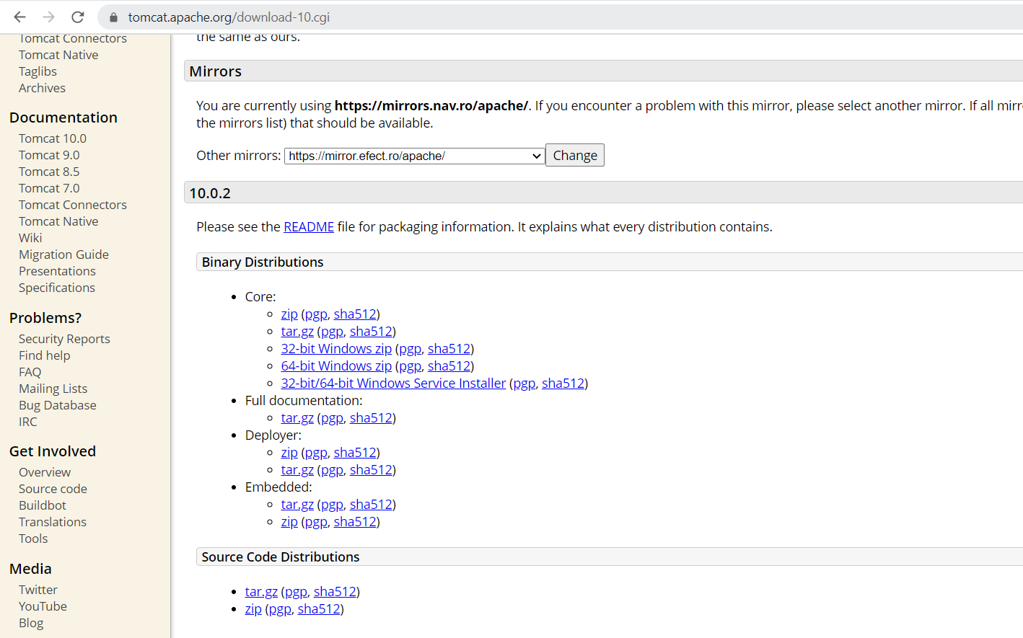
What is Apache Tomcat?
Set up
Download Tomcat 10 from Apache: tomcat.apache.org Tomcat 10 implements Servlet Spec 5.0

Slide 34
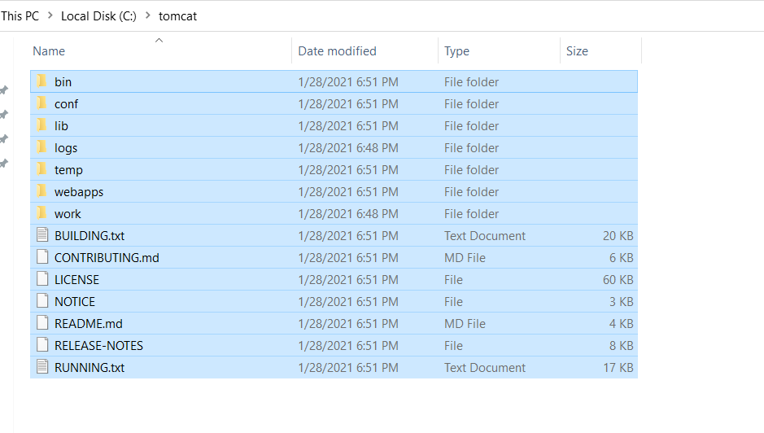
What is Apache Tomcat?
Set up
Installation Unzip it and put it under the C drive

Slide 35
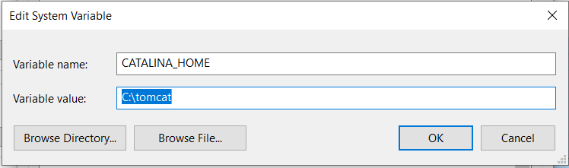
What is Apache Tomcat?
Set up
Add environment variables JAVA_HOME CATALINA_HOME

Slide 36
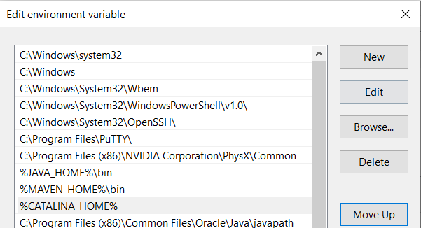
What is Apache Tomcat?
Set up
Edit environment variable Path

Slide 37
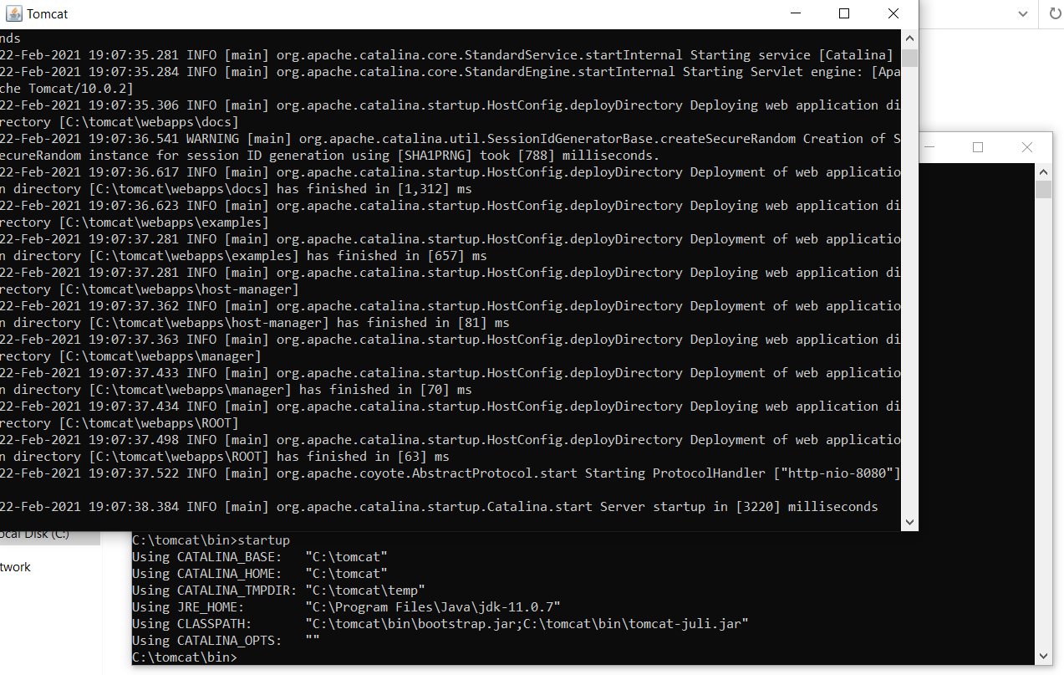
What is Apache Tomcat?
Set up
Start Tomcat In bin folder run startup.bat

Slide 38
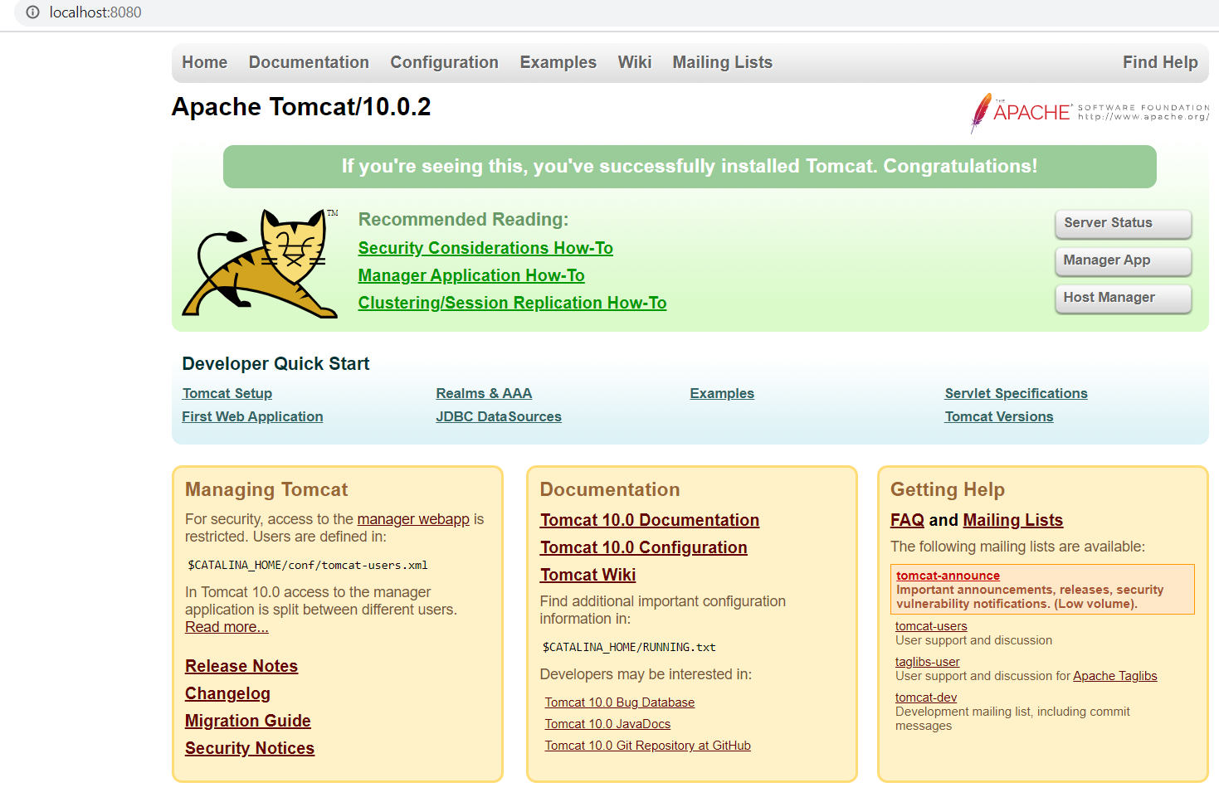
What is Apache Tomcat?
Set up
Test Tomcat installation Open a browser and navigate to localhost:8080

Slide 39
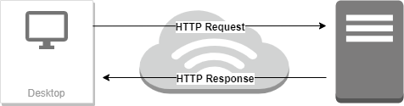
What is Apache Tomcat?
Just a little bit about HTTP
HTTP Communication protocol between browser and web server Uses plain text

Slide 40
What is Apache Tomcat?
Basic application example
Create new web app project
Open IDE
File -> New Project ->
Maven -> JDK 11 ->
Create from archetype (maven-archetype-webapp)
Configure name and artifact coordinates (GAV) -> Next
Validate setup -> Finish

Slide 41
What is Apache Tomcat?
Basic application example
Configure web app
Add the servlet dependency
In pom.xml file ->
Alt + Insert -> choose Dependency ->
Search for jakarta.servlet-api
Maven -> reload project
Override maven.compiler.source and maven.compiler.target to 11
Create packages according to group id
Add a new Java class for Servlet
Override doGet method
Add WebServlet annotation

Slide 42
What is Apache Tomcat?
Basic application example
Build web app
mvn clean package
Deploy web app
Go to target
Copy .war file to tomcat\webapps
Start tomcat
Check your app in browser at the URL
localhost:8080/_warname_/_servletpath_

Slide 43
What is Git?

Slide 44

What is Git?
What is ...
a versioning control system (VCS) ?
GIT?
Gitlab and how it relates to GIT?
a branch?

Slide 45
What is Git?
Repository interaction commands:
Fetch
Push
Local commands:
Status
Checkout
Merge
Commit

Slide 46
Lab exercises

Slide 47
Lab exercises
Download and install JDK11
Download IntelliJ
Download and setup Maven
Create Maven application using IntelliJ
Download and setup Apache Tomcat
Create simple Web application from IDE
Deploy web application on Tomcat
Create a Github account
Create Git repository

Slide 48
Thank You!

